Slide 1

Condition-Based Maintenance
of Naval Propulsion System
Anusha Karunakaran
Balpreet Sawhney
Raja Tulsiyani
Shrey Modi

Slide 2
Agenda
Overview of Naval Propulsion System
Need for Maintenance
Overview of Data
SEMMA Approach
Conclusion

Slide 3
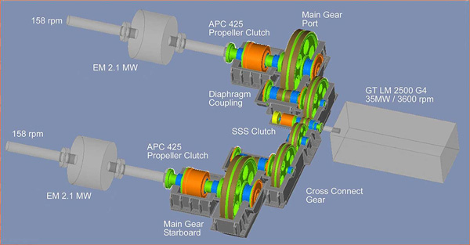
Combined Diesel Electric Gas (CODLAG) Generator

Slide 4
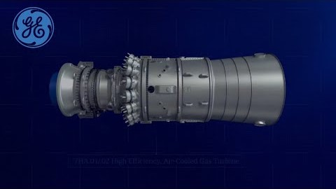
Gas Turbine

Slide 5
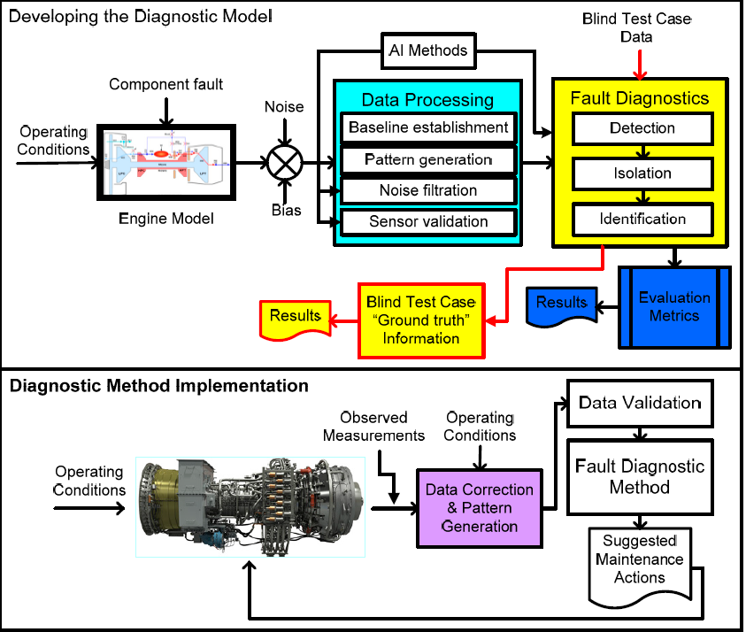
Diagnosis

Slide 6
Condition-Based Maintenance: Definition
Maintenance actions are taken according to the actual condition of the operating engines, which is assessed through appropriate condition monitoring procedures.

Slide 7
Obsolete Ways of Maintenance
Un-planned Production Shutdowns
Inefficient Use of Resources
High Monitoring Costs

Slide 8
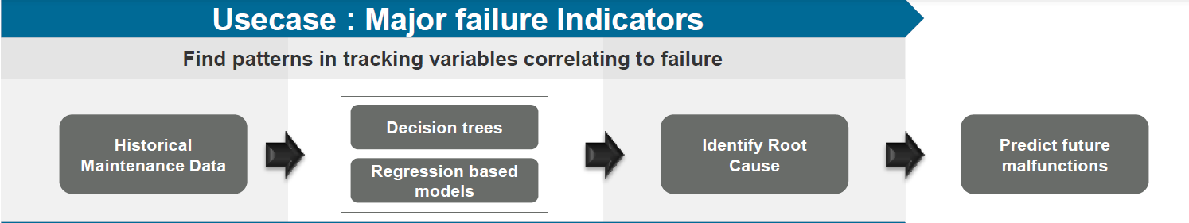
Problem Statement

Slide 9
How to do it?
• Data Acquisition – Data acquired from engines under monitoring
• Data Processing – Acquired Data is validated and transformed properly according to the requirements
• Decision Making – A number of methods and techniques are applied to obtain the current health condition of the engine and recommend maintenance plans

Slide 10
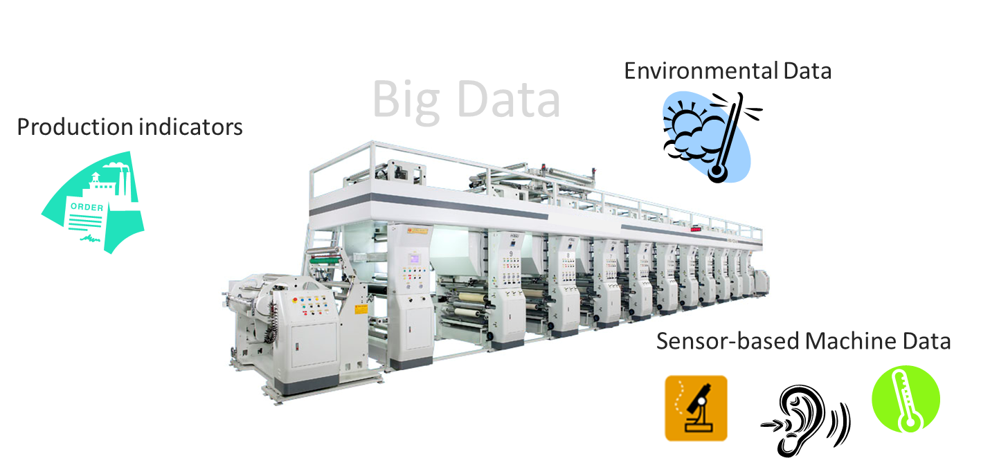
Data Collection and Maintenance

Slide 11
Why Maintenance is Required?
So, how can we efficiently do it?
International Competition
Shorter Product Life Cycles
New Business Processes
Fast Technological Leaps
Predictive Maintenance

Slide 12
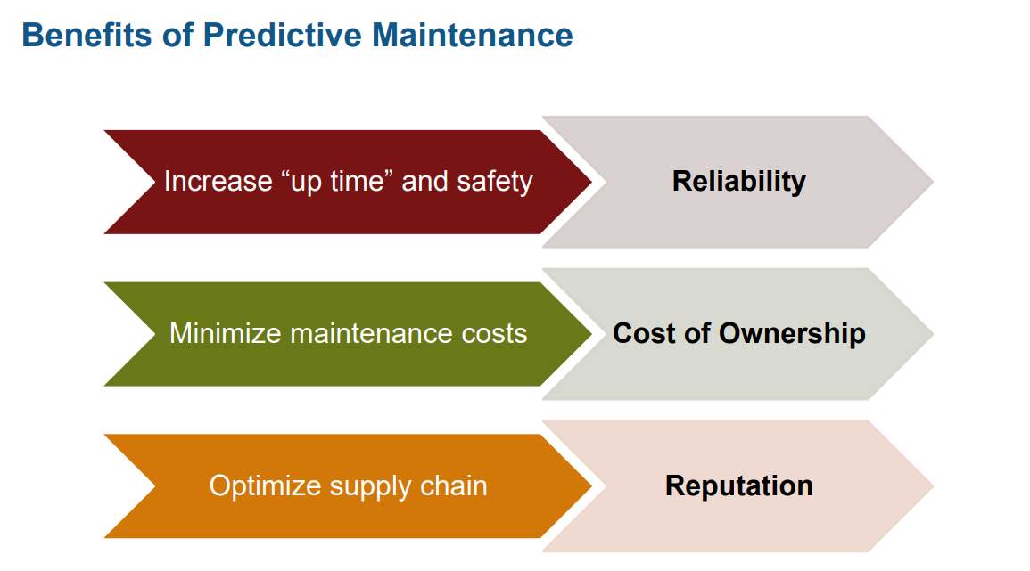
Benefits of Predictive Maintenance

Slide 13
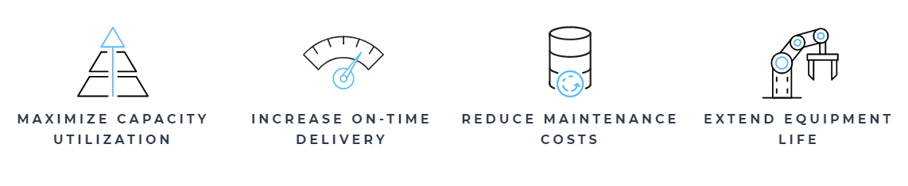
Creating Business Value with Predictive Maintenance
How analyzing data from sensors can create game-changing ways in

Slide 14
SEMMA Approach
SEMMA is an acronym that stands for Sample, Explore, Modify, Model, and Assess. It is a list of sequential steps developed by SAS Institute, one of the largest producers of statistics and business intelligence software. It guides the implementation of data mining applications. The steps are as follows:

Slide 15
Step 1: Sample the Data
The process starts with data sampling, e.g., selecting the data set for modeling. The data set should be large enough to contain sufficient information to retrieve, yet small enough to be used efficiently.
In our project, we considered taking complete data since the number of rows in our data of interest are ~11,000 which is small enough to sample.

Slide 16
Step 2: Explore
This phase covers the understanding of the data by discovering anticipated and unanticipated relationships between the variables, and also abnormalities, with the help of data visualization.
The relation between various predictors was determined to see if there are any outliers .
Going forward, we show you our steps to determine anomalies (outliers), missing values (if any) in our data.

Slide 17
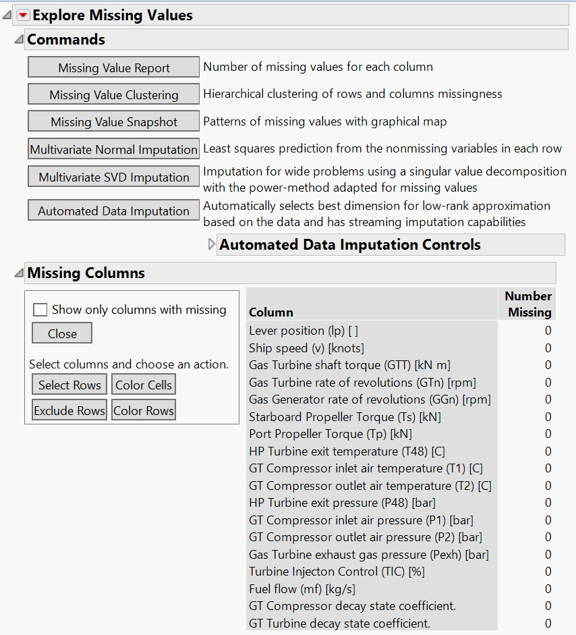
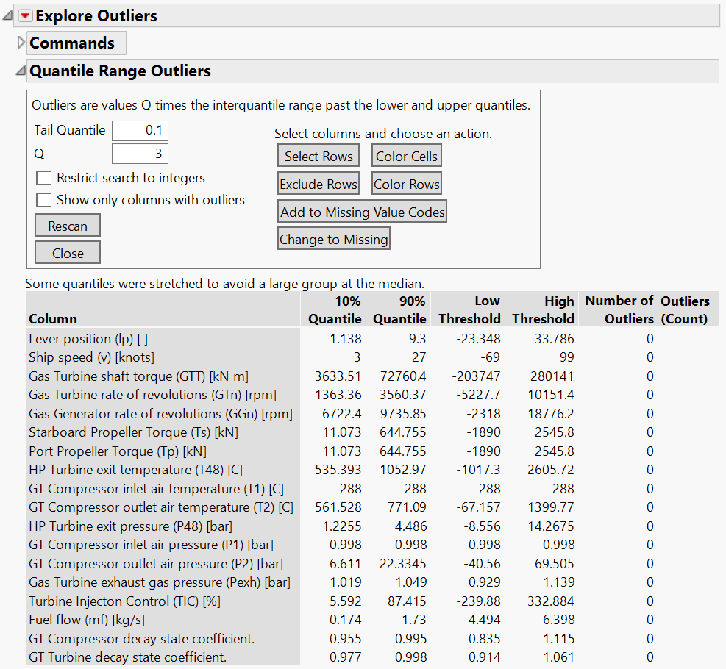
Missing Values and Outliers

Slide 18
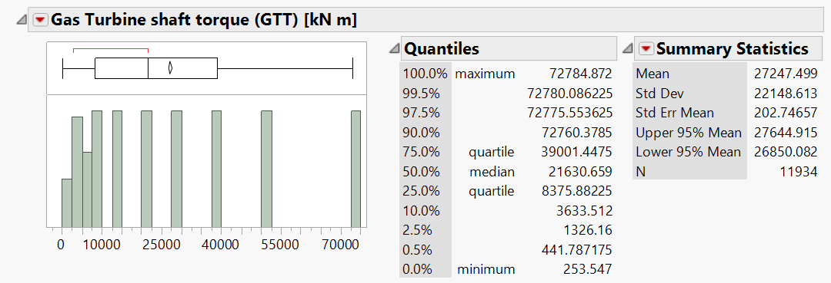
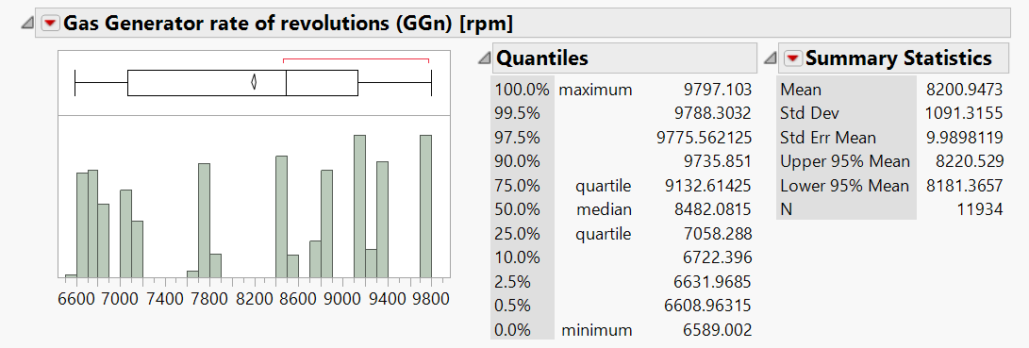
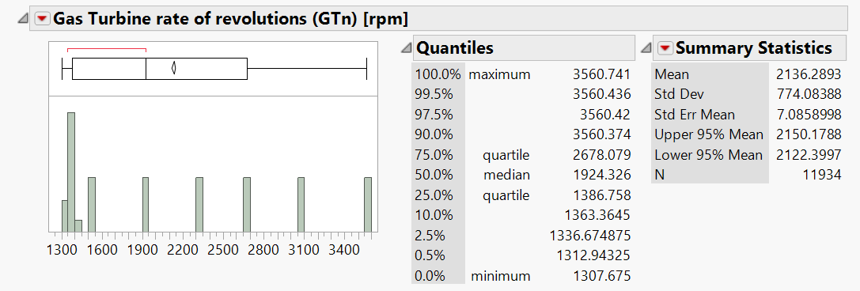
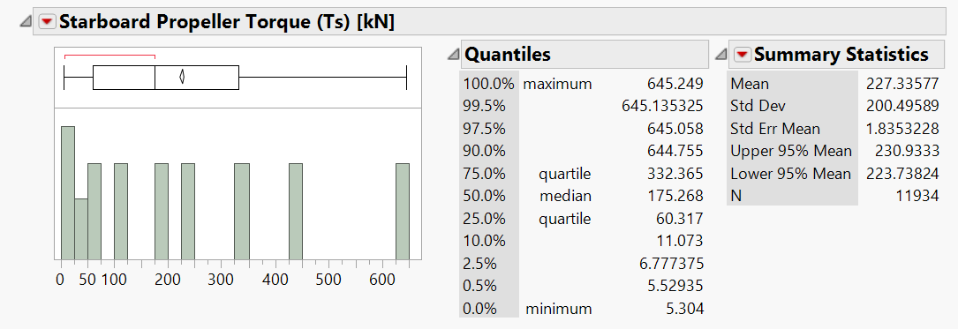
Column Summary Statistics

Slide 19
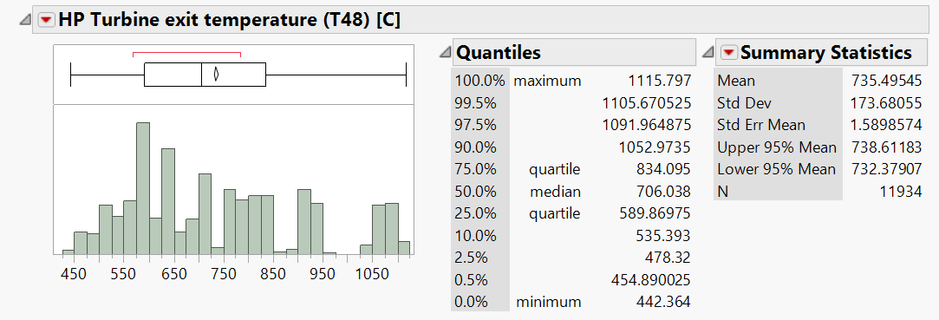
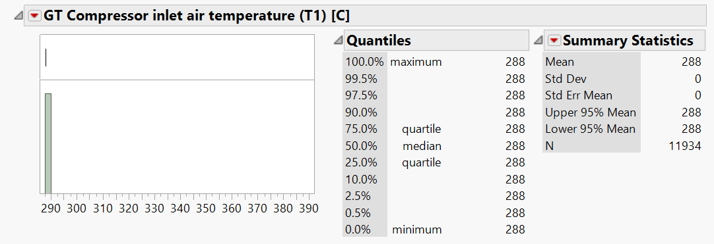
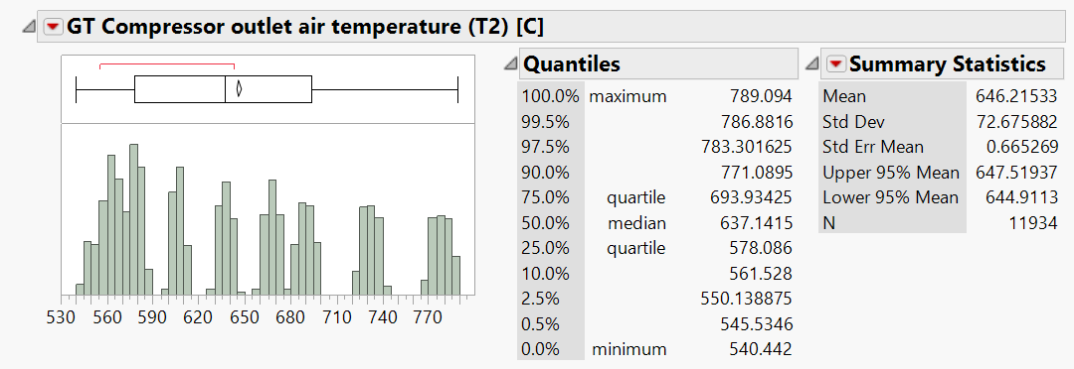
Column Summary Statistics

Slide 20
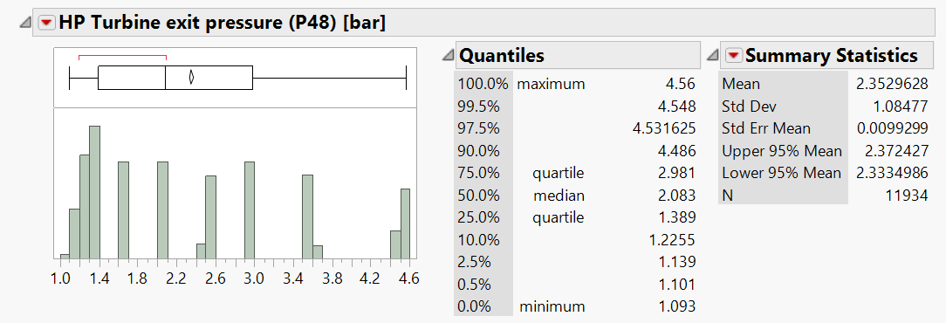

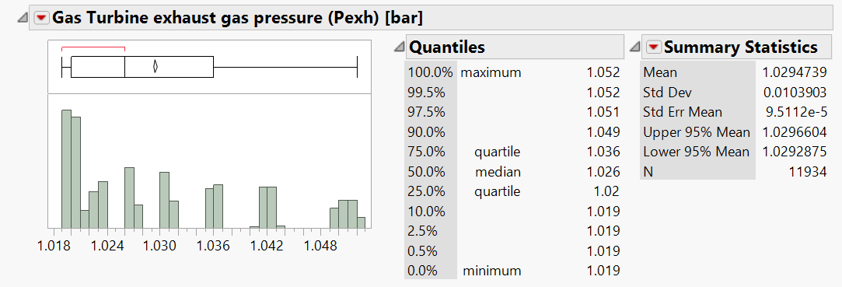
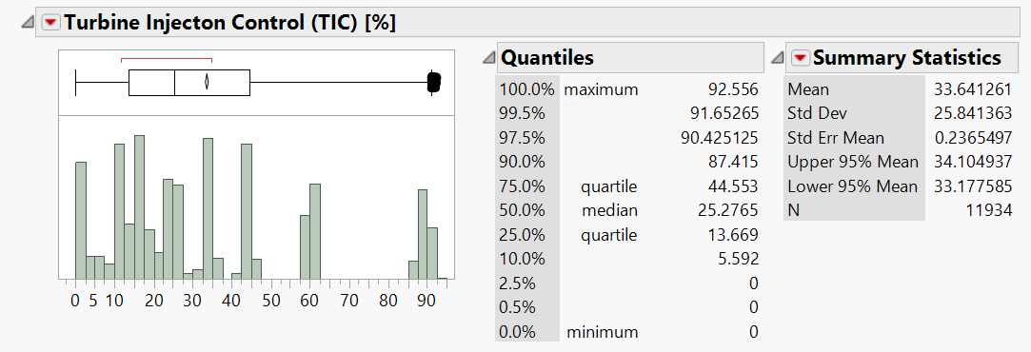
Column Summary Statistics

Slide 21
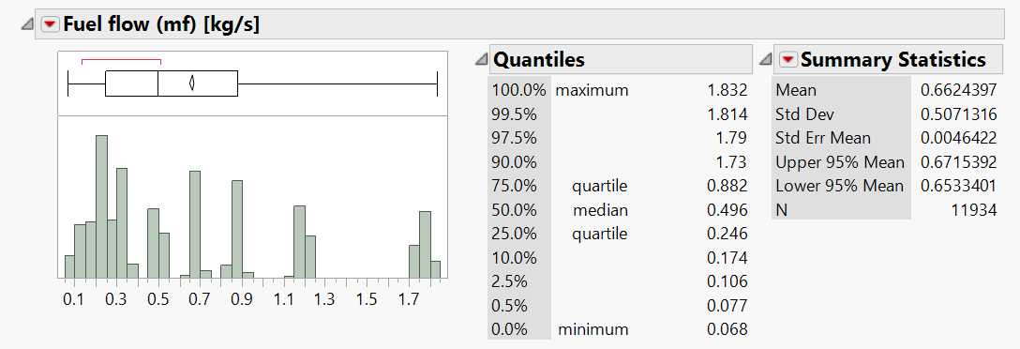
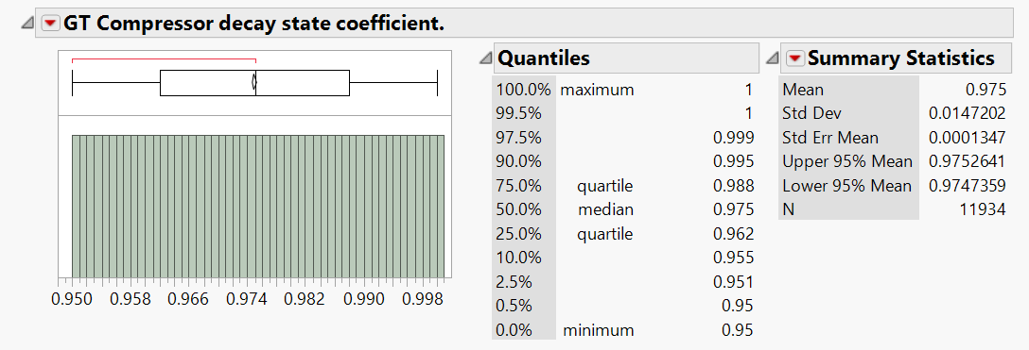
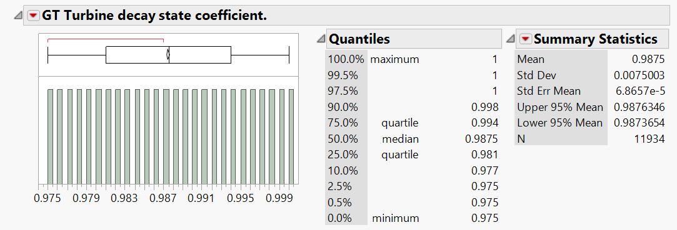
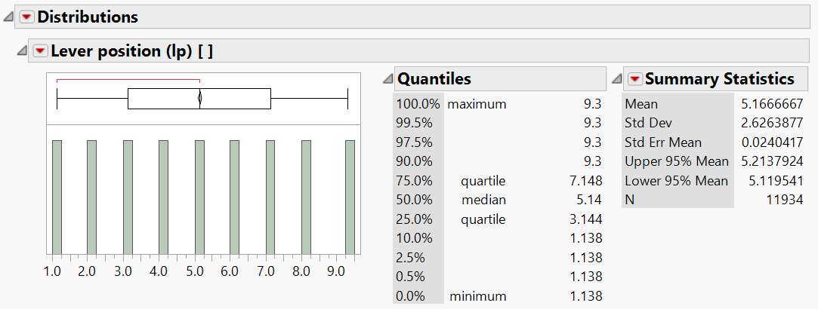
Column Summary Statistics

Slide 22
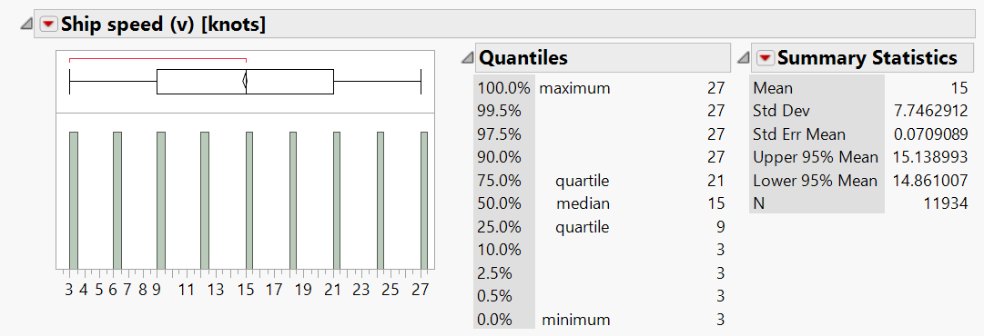
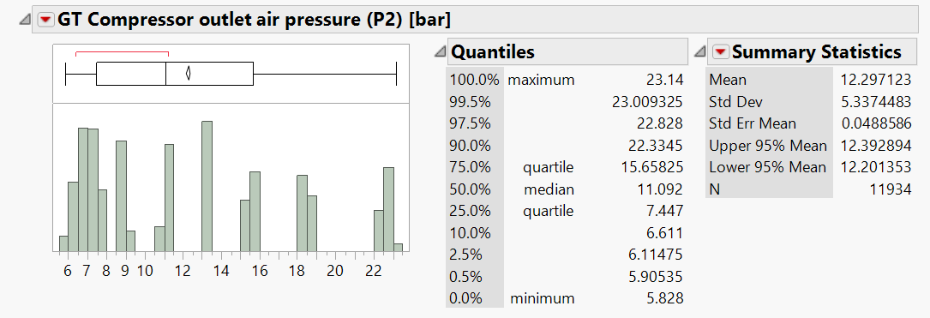
Column Summary Statistics

Slide 23
Step 3: Modify
The Modify phase contains methods to select, create and transform variables in preparation for data modeling.
We transformed the fields to model our data in such a way that we can easily determine the values of GT Compressor decay state coefficient and GT Turbine decay state coefficient

Slide 24
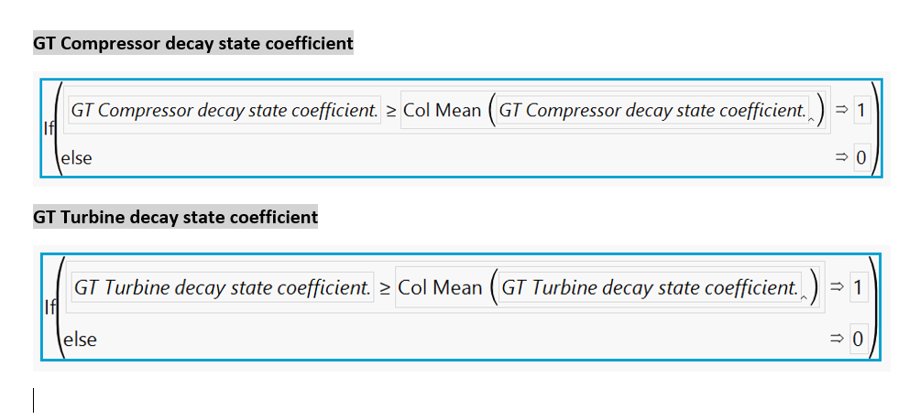
Modified Columns
GT Compressor Decay Flag =
GT Turbine Decay Flag =

Slide 25
Step 4: Model
In the Model phase the focus is on applying various modeling (data mining) techniques on the prepared variables in order to create models that possibly provide the desired outcome.
We used the multivariate components method and then Principal Components to model the data in such a way that we choose the least redundant predictors and get the best out of the data.

Slide 26
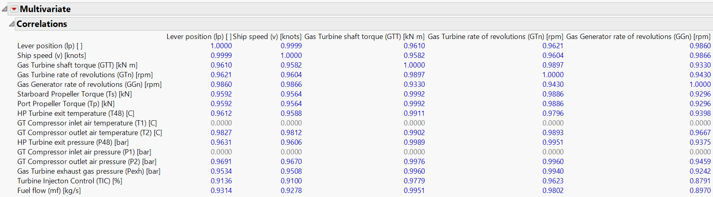
Correlation Between Independent Variables

Slide 27
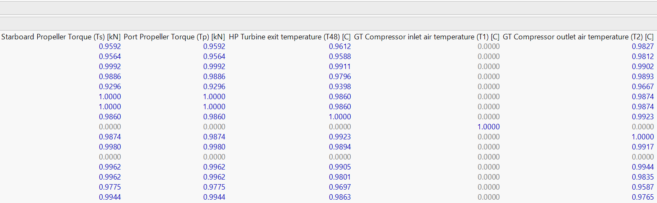
Correlation Between Independent Variables

Slide 28
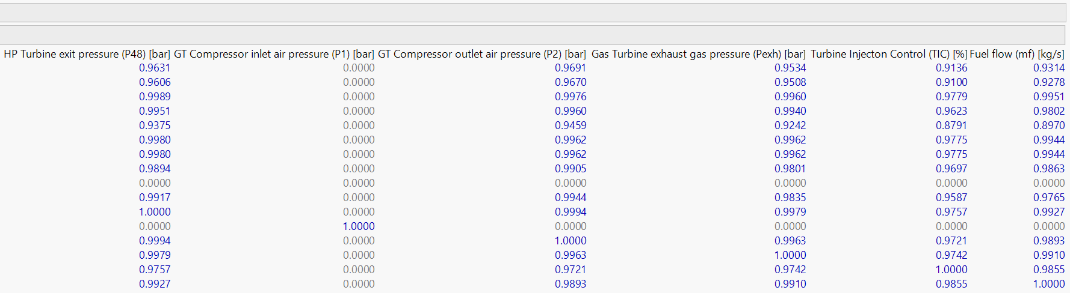
Correlation Between Independent Variables

Slide 29
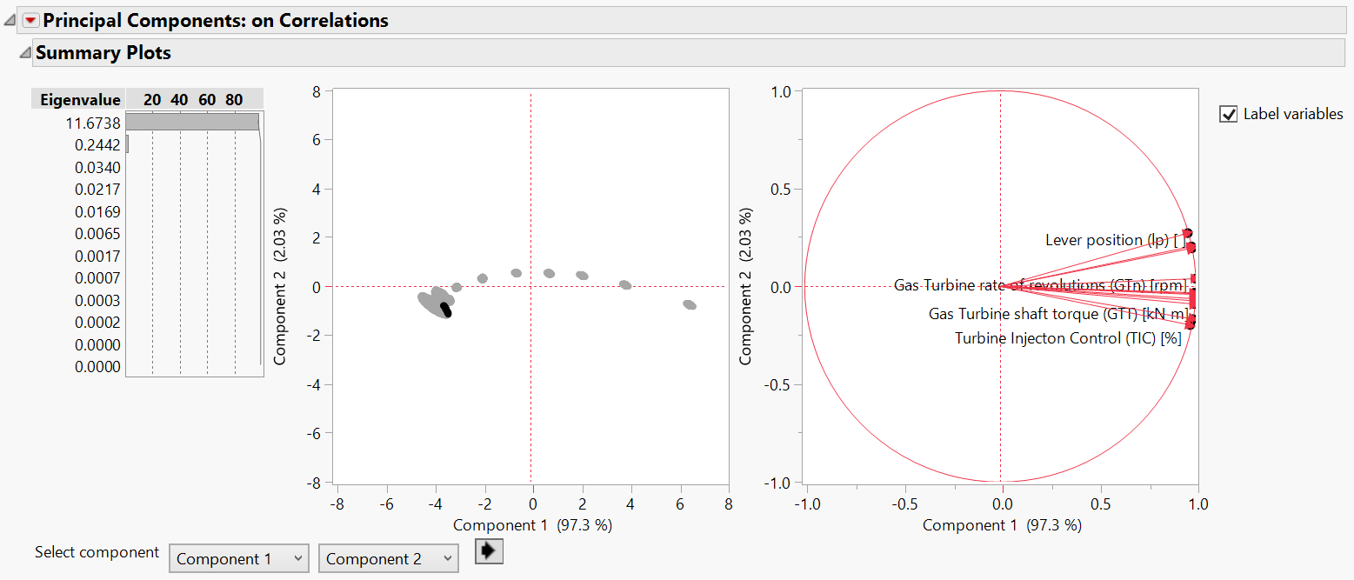
Principal Component Analysis

Slide 30
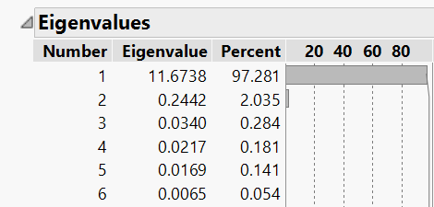
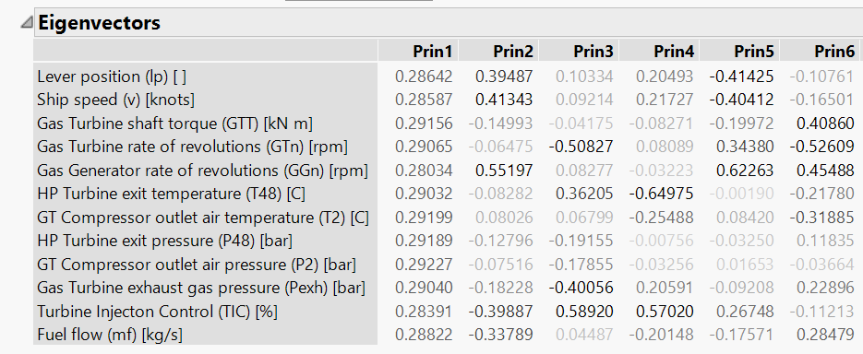
Principal Component Analysis

Slide 31
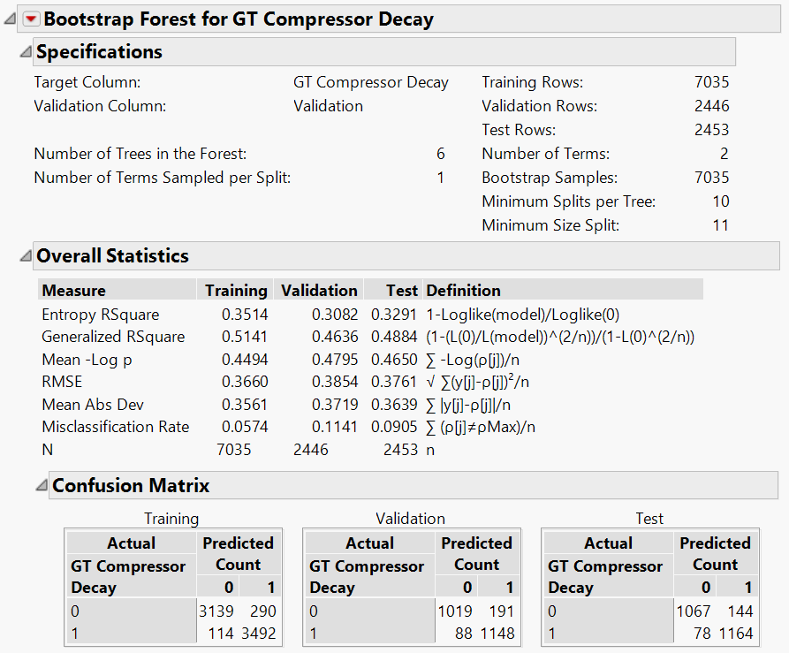

Model Accuracy Using Principal Components

Slide 32
Step 5: Assess
Assess your data by evaluating the usefulness and reliability of the findings from the data mining process and estimate how well it performs. A common means of assessing a model is to apply it to a portion of data set aside during the sampling stage. If the model is valid, it should work for this reserved sample as well as for the sample used to construct the model. Similarly, you can test the model against known data.
To assess our model, we ran various Supervised Techniques and hence came to the conclusion.

Slide 33
Step 5: Assess
For this model, the following are the Supervised techniques used to predict the maintenance through Compressor Decay coefficient and Turbine Decay coefficient :
Random Forest (Bootstrap)
Logistic Regression

Slide 34
Bootstrap Forest for GT Compressor Decay
The Bootstrap Forest platform fits an ensemble model by averaging many decision trees each of which is fit to a bootstrap sample of the training data. Each split in each tree considers a random subset of the predictors. In this way, many weak models are combined to produce a more powerful model. The final prediction for an observation is the average of the predicted values for that observation over all the decision trees.
Setting up the seed to 8 and then running the bootstrap model as shown:

Slide 35
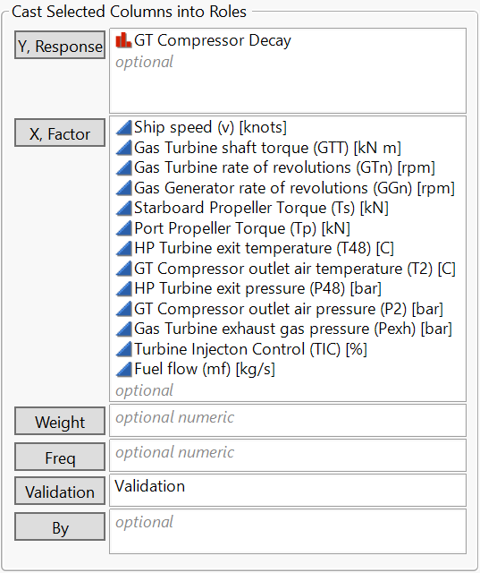
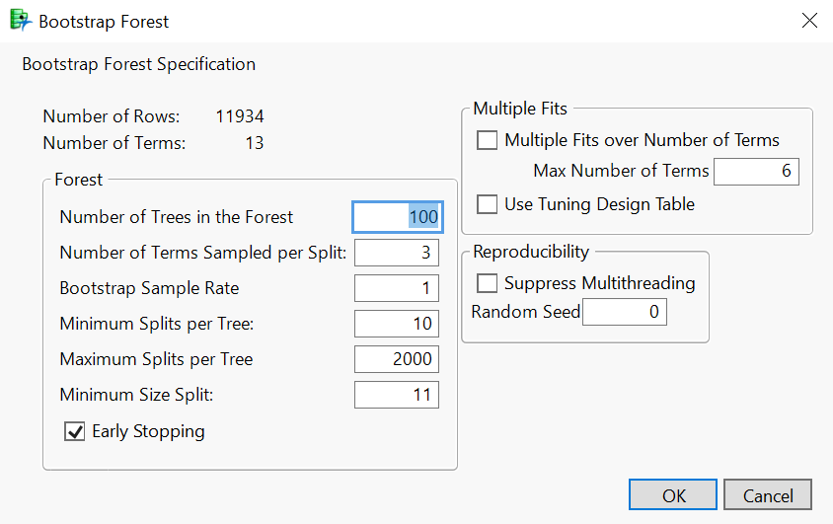
Model Input

Slide 36
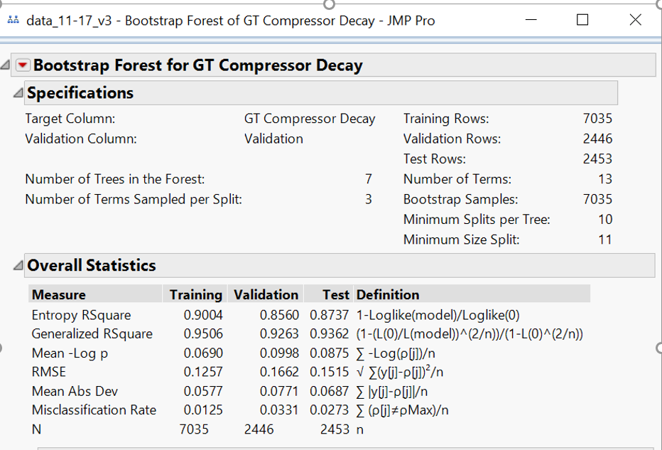
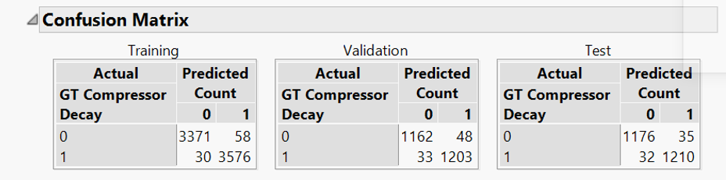
Model Output

Slide 37
Logistic Regression for GT Turbine Decay
Logistic regression is a predictive modelling algorithm that is used when the Y variable is binary categorical. That is, it can take only two values like 1 or 0. The goal is to determine a mathematical equation that can be used to predict the probability of event 1. Once the equation is established, it can be used to predict the Y when only the X’s are known.
On applying Logistic Regression on our model , we got the results as follows:

Slide 38
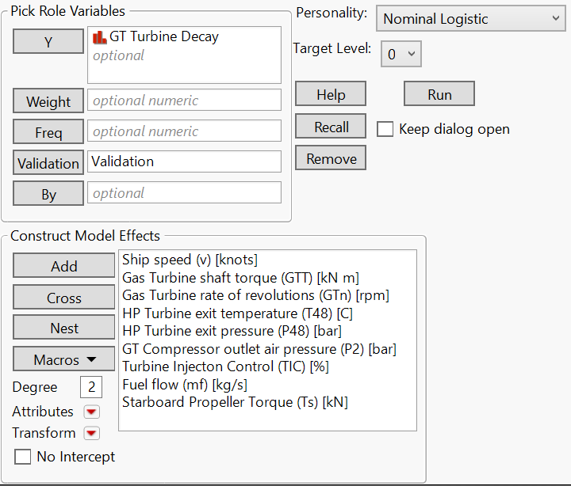
Model Input

Slide 39
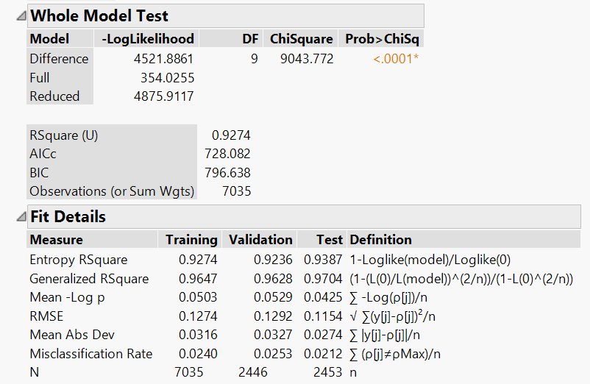
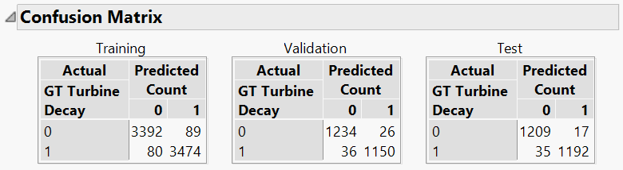
Model Output

Slide 40
Model Accuracy for Compressor and Turbine
<Need to Work on this slide>

Slide 41
Conclusion
Gas turbine (GT) gas-path fault diagnostics is a key element of an overall engine condition-based monitoring (CBM) system providing enhanced safety, reliability, and availability along with optimal operation and maintenance costs.
The easiest way to get started is with an industrial platform centered on a rule-based model, which enables teams to quickly define, simulate and deploy a predictive maintenance solution for their products.

